Slide 2
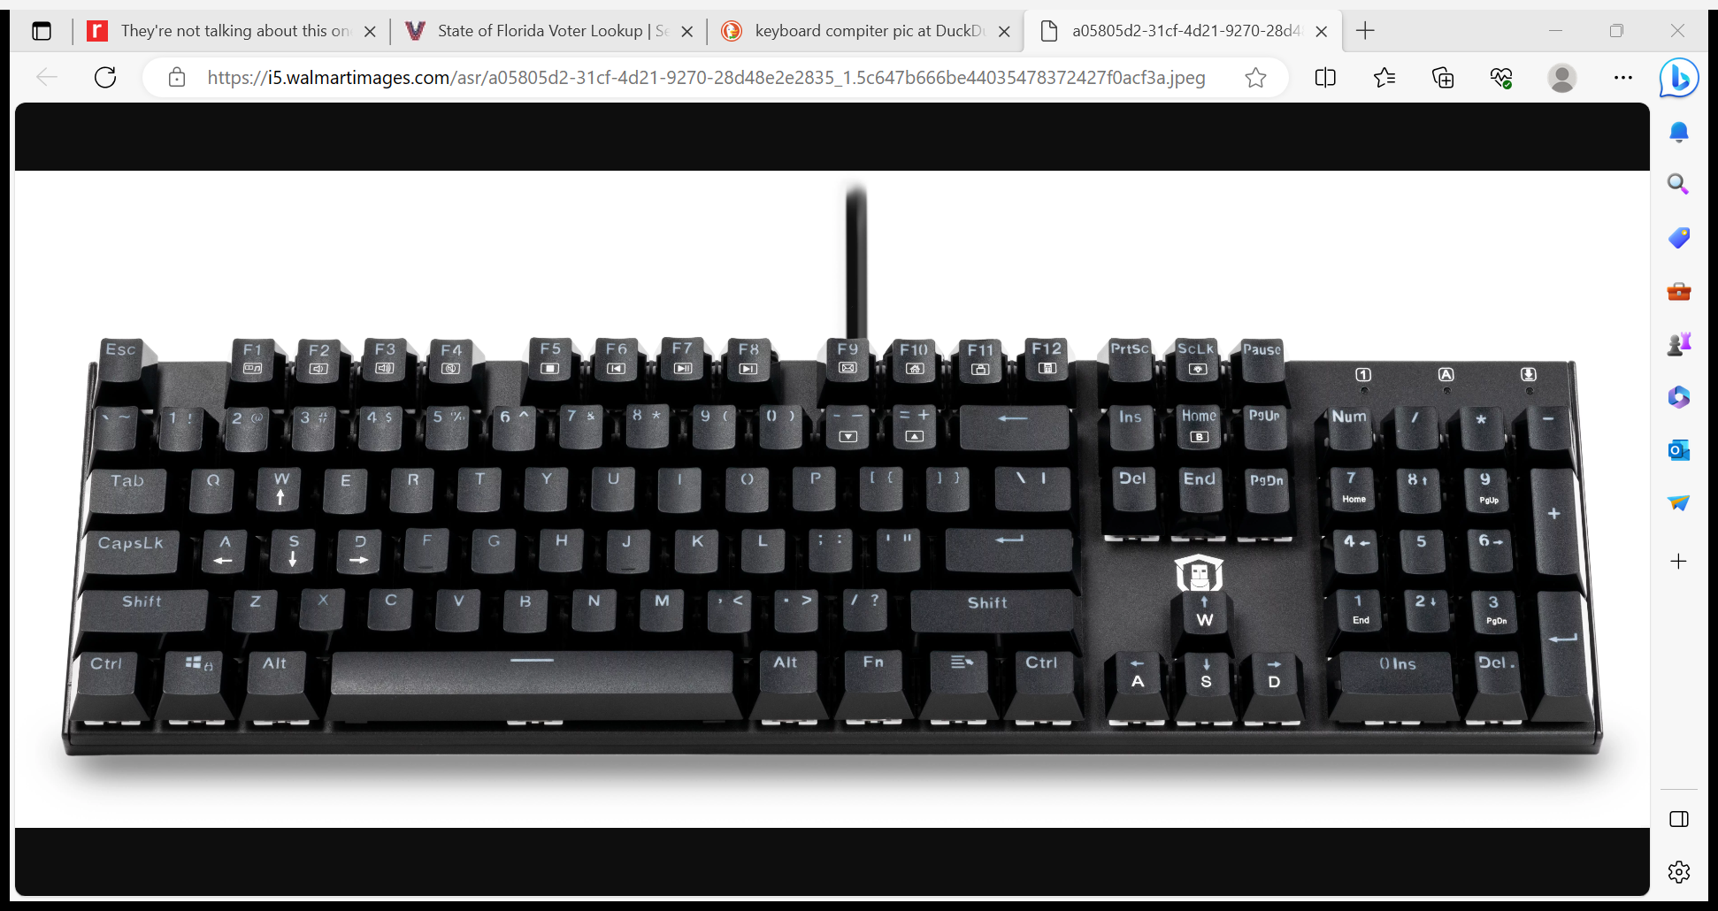
HOW TO SCREENSHOT
A SCREENSHOT takes a photo of whatever is on your computer screen.
Most computers SCREENSHOT by pressing 2 keys at the same time
ALT
PRT SCR

Slide 3
HOW TO PASTE ON WORD DOC
IMMEDIATELY after you SCREENSHOT
Go to open WORD doc
Right click mouse or pad
Select PASTE
Your SCREENSHOT should appear
Keep PASTING SCREENSHOTS to WORD doc
After you finish WORD doc, SAVE with your initials and date (only spaces)
Email doc to leader

Slide 4
ANGELS

Slide 5
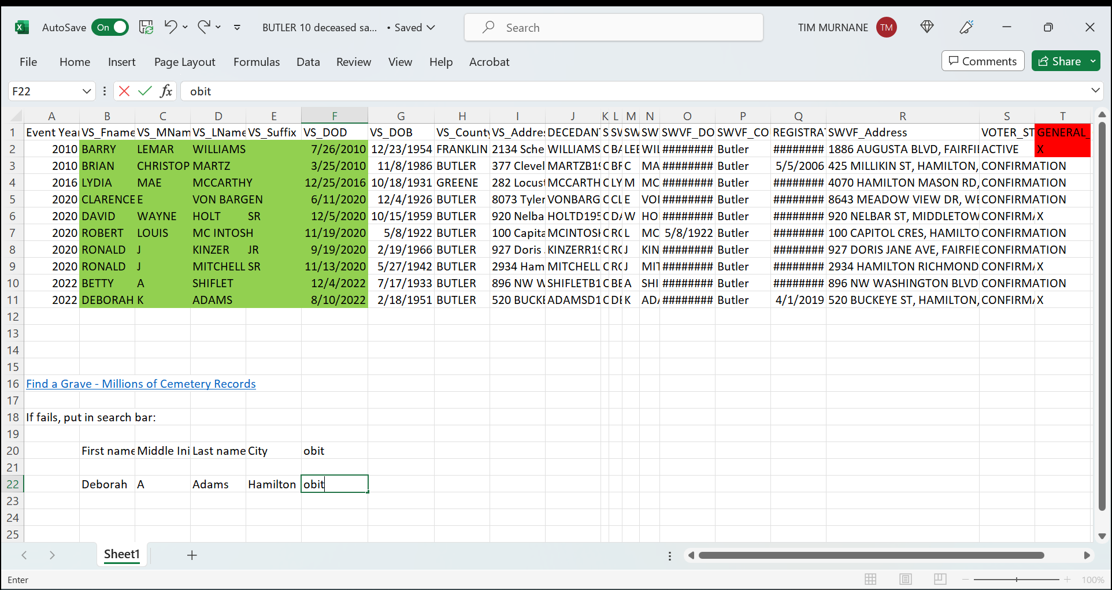
GO TO YOUR COUNTY ANGELS PAGE ON SPREADSHEET

Slide 6
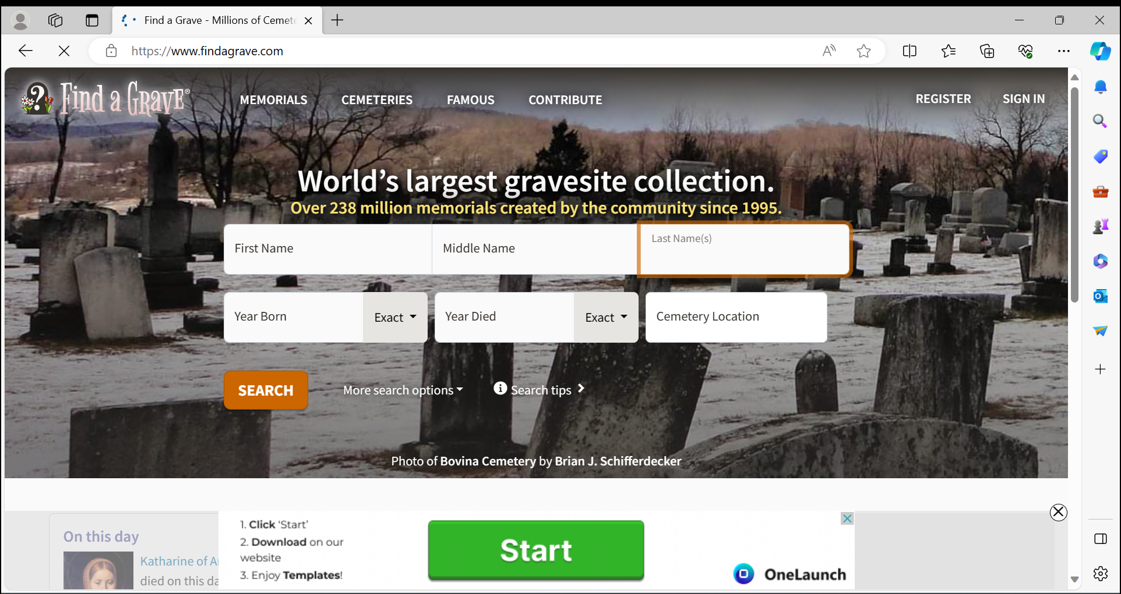

Slide 7
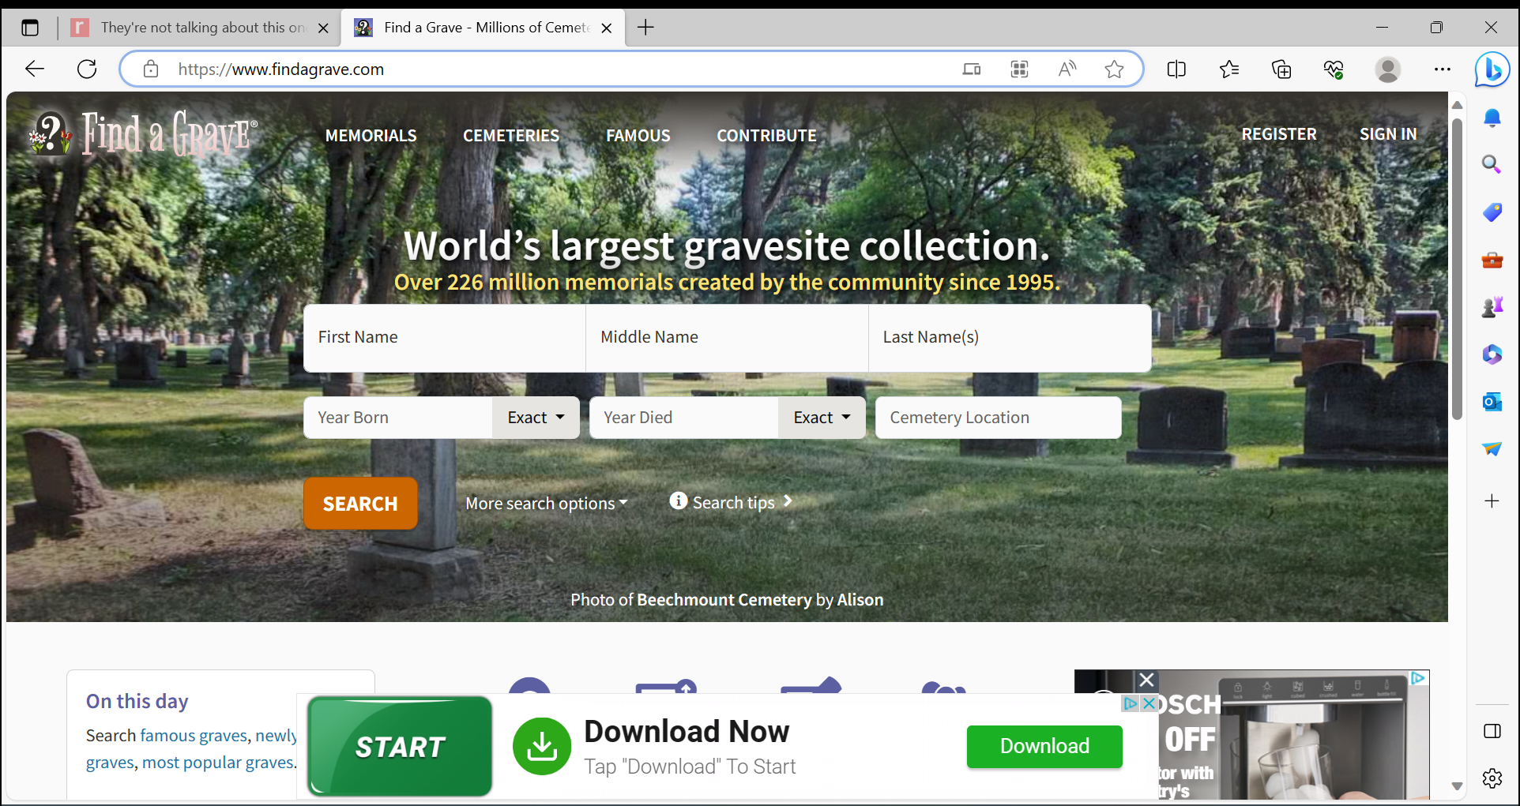
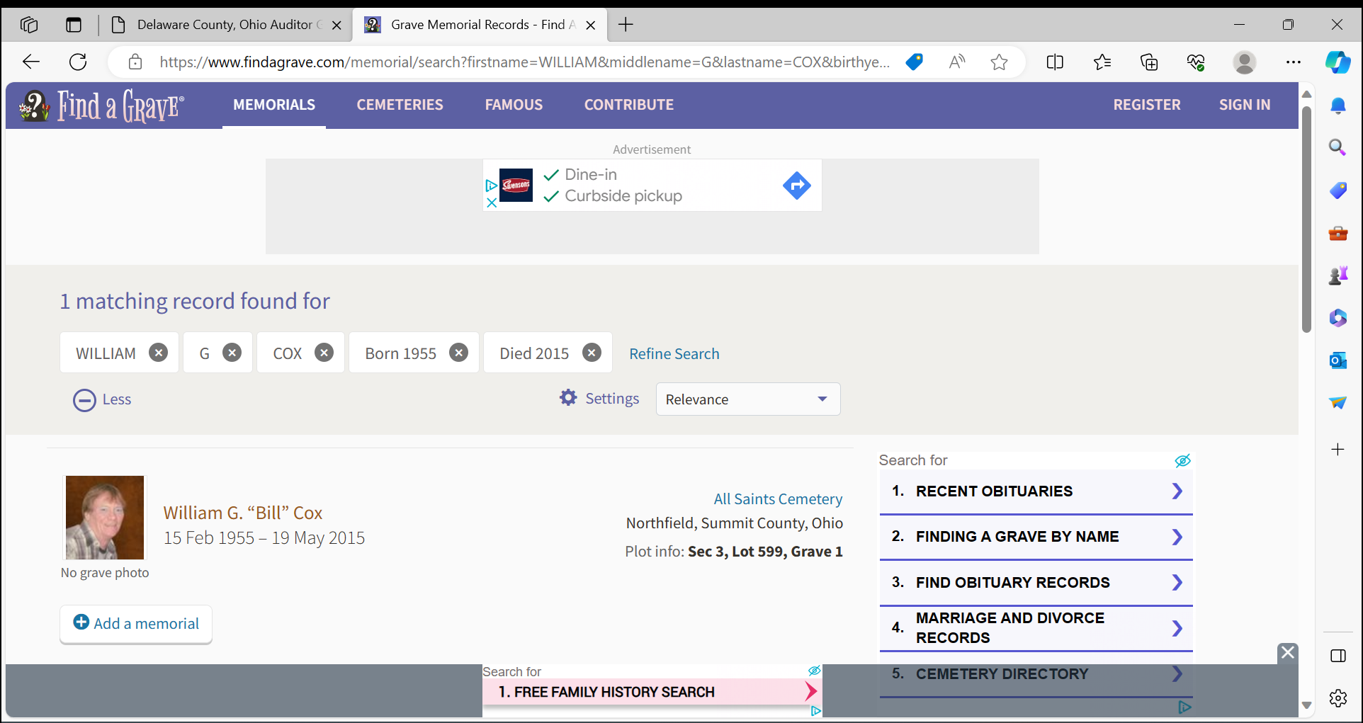

Slide 8
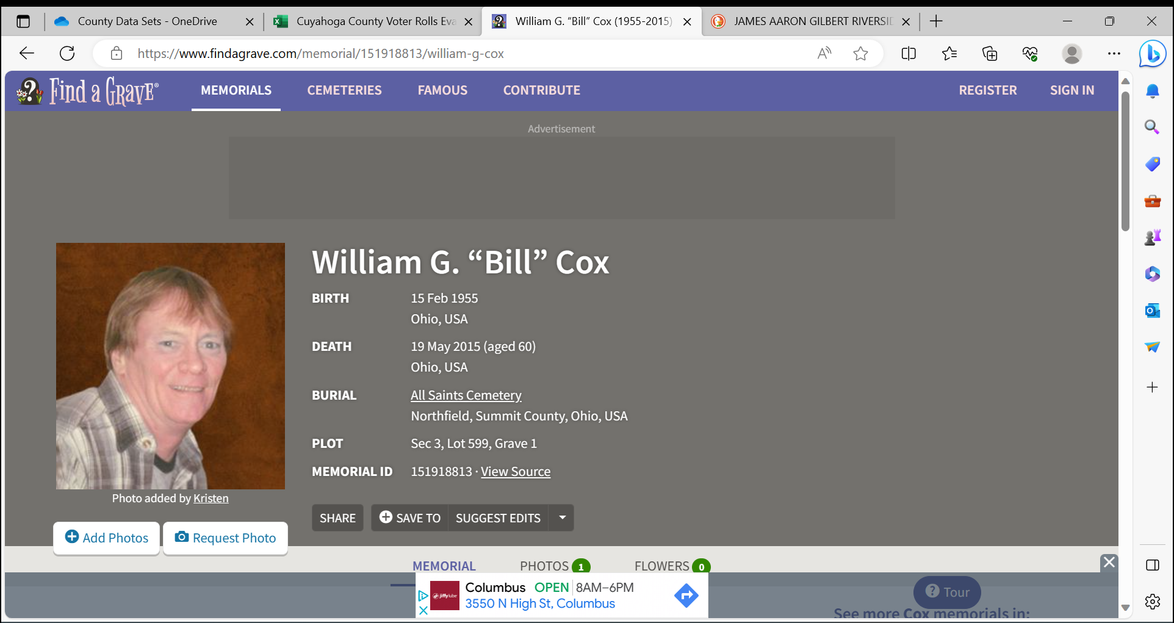

Slide 9
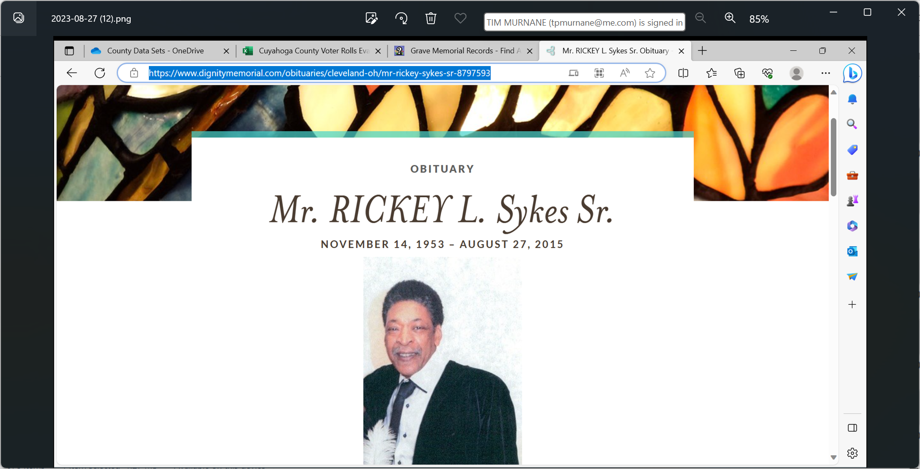
WHAT IF ANGEL NOT ON FINDAGRAVE?
Find the Obituary
In search bar enter
Name
City
Obituary
Screenshot
add to WORD doc

Slide 10
UPS

Slide 11
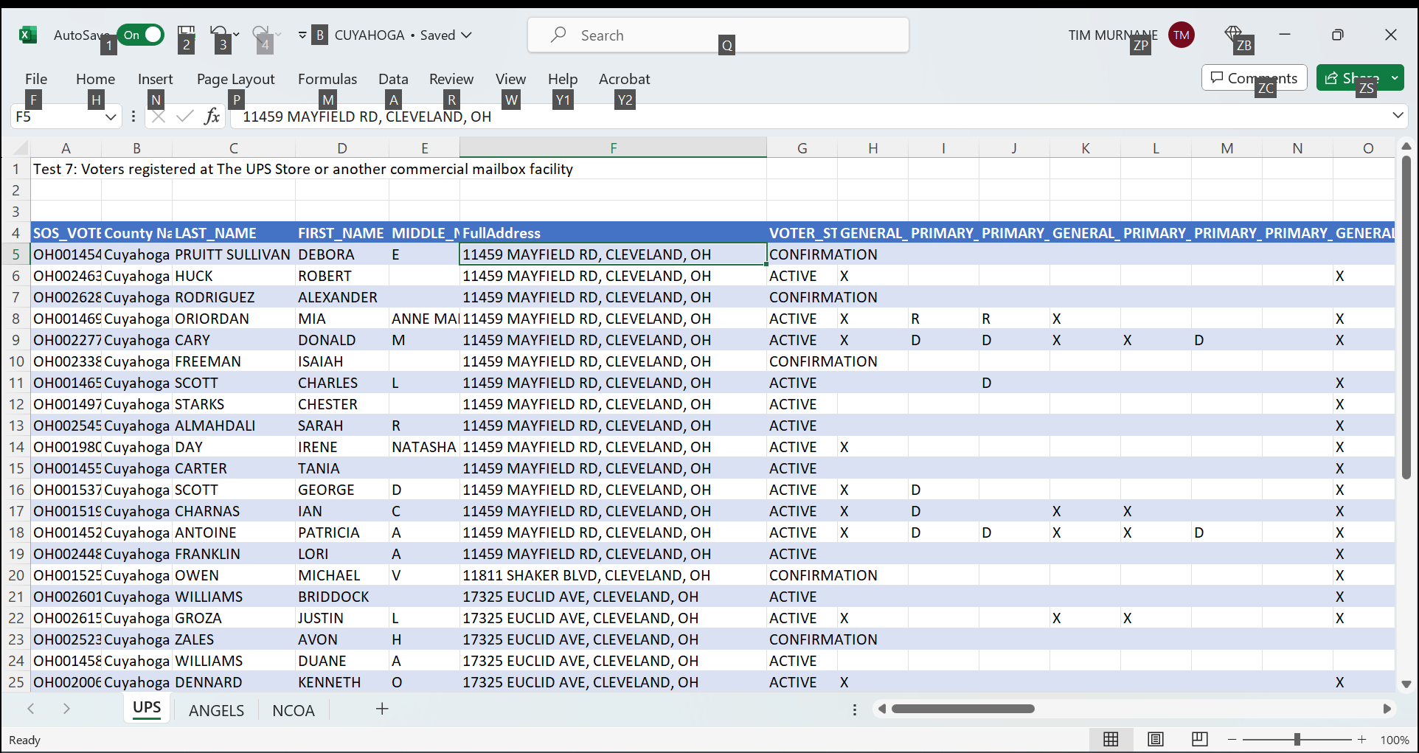
UPS
SEARCH ADDRESS OF UPS STORE ON NET
SCREENSHOT RESULTS TO WORD DOC, SAVE SEND TO LEADER

Slide 12
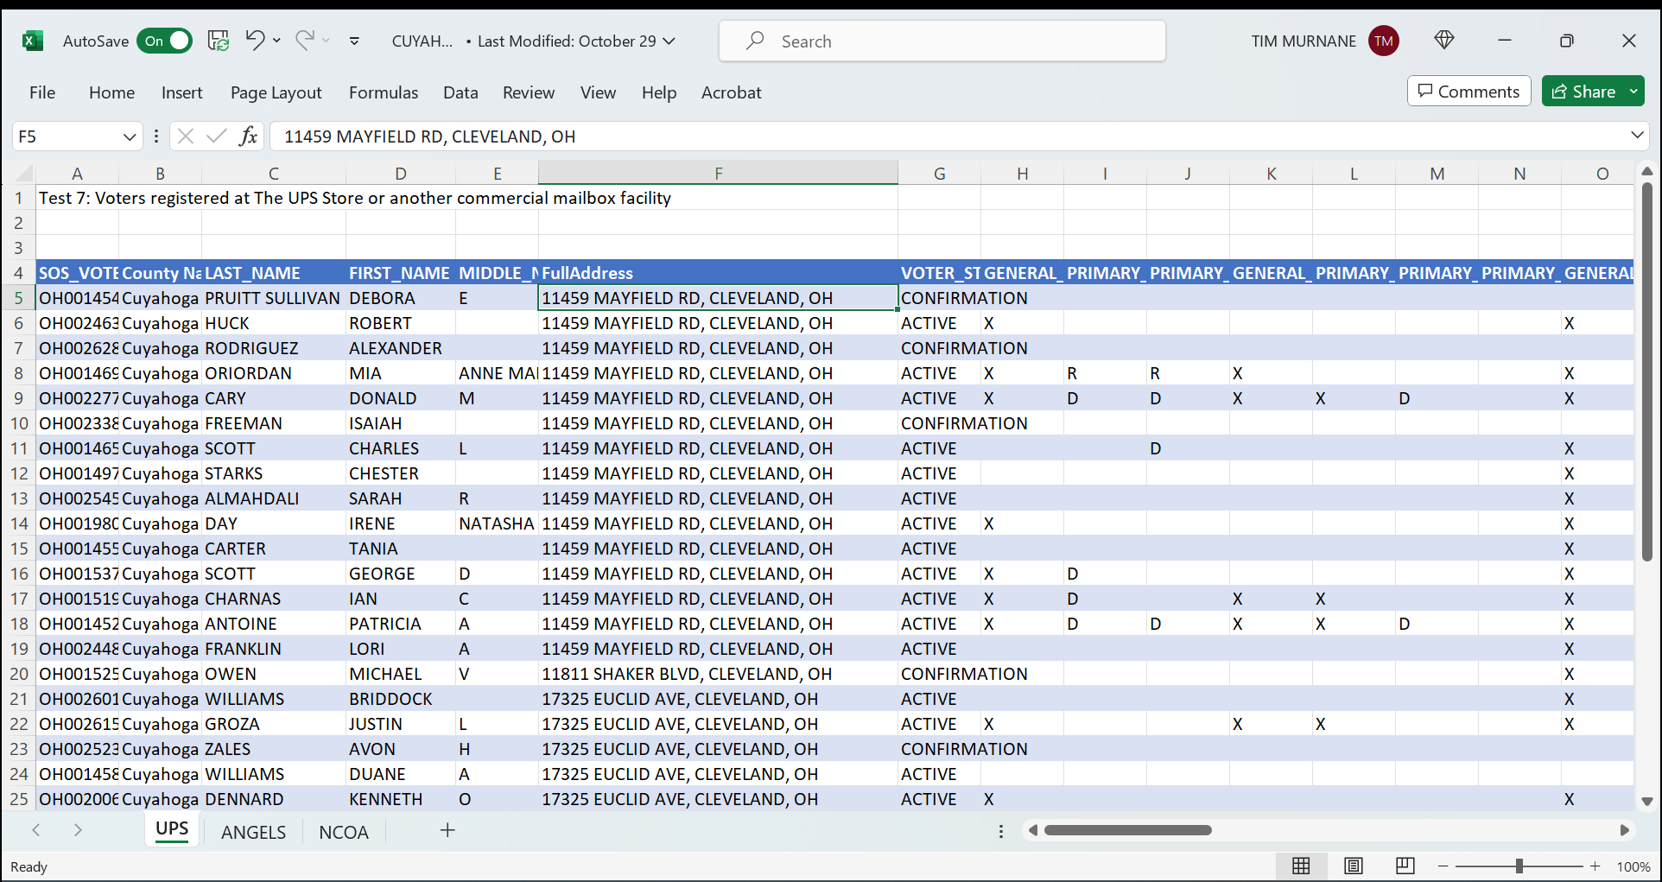
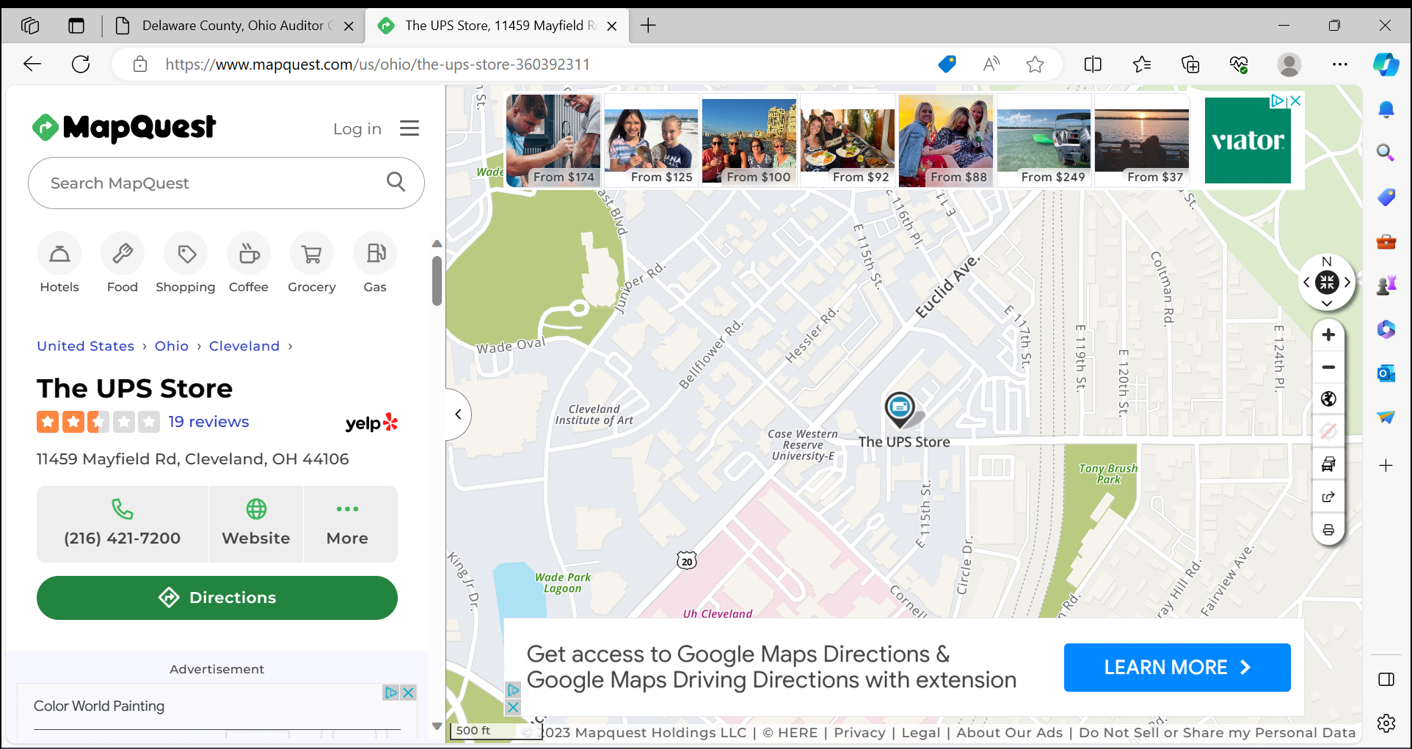
COMMERCIAL
SEARCH ADDRESS ON NET
SCREENSHOT, COPY TO WORD DOC

Slide 13
SCREENSHOT
PASTE
new doc
EMAIL TO LEADER

Slide 14
NCOA
FIND EX-BUCKEYES WHO ARE VOTING IN THEIR NEW STATE

Slide 15
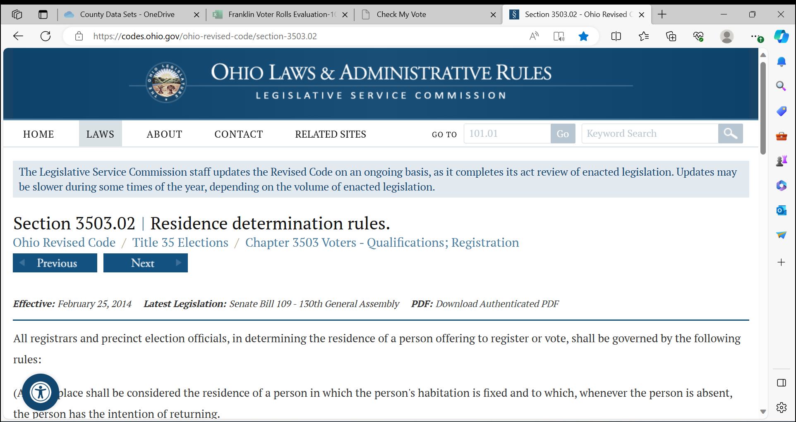

Slide 16
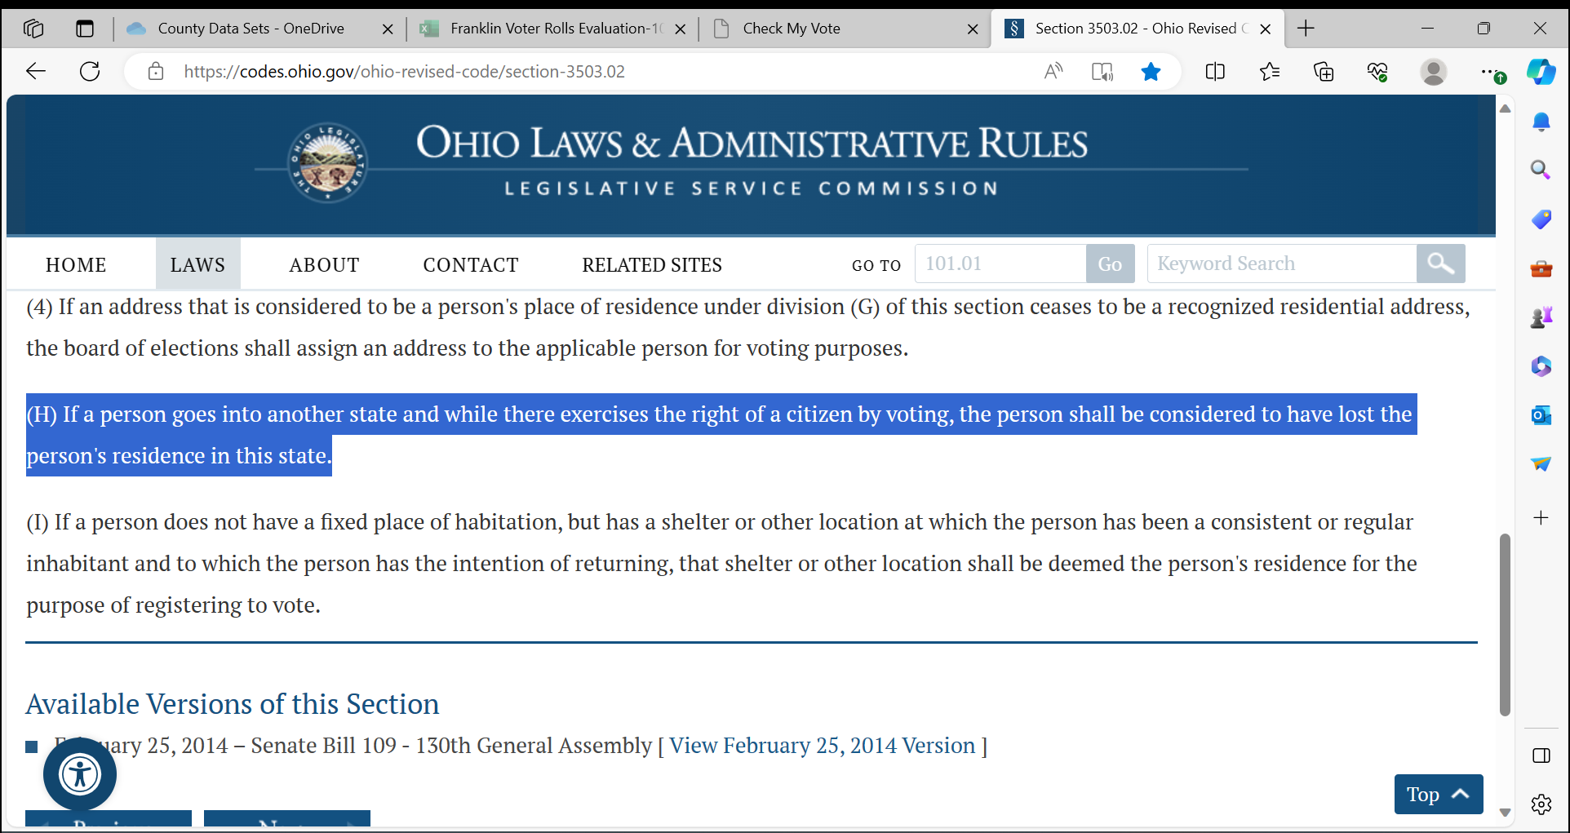

Slide 17
WE CAN FIND VOTER INFORMATION IN 3 STATES
FLORIDA
NORTH CAROLINA
MICHIGAN

Slide 18
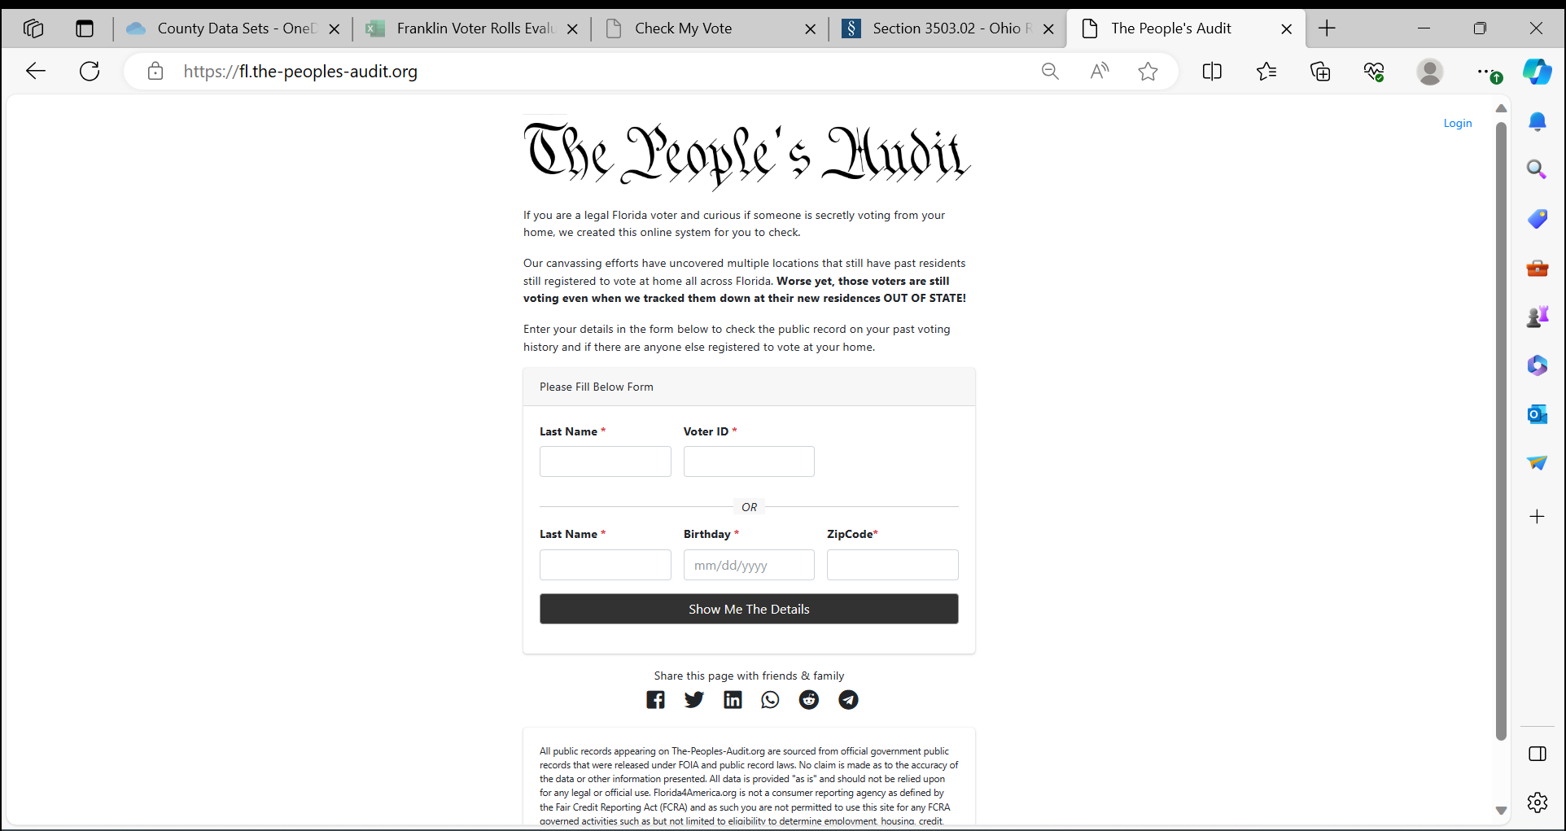
FLORIDA
Go to https://fl.the-peoples-audit.org/

Slide 20
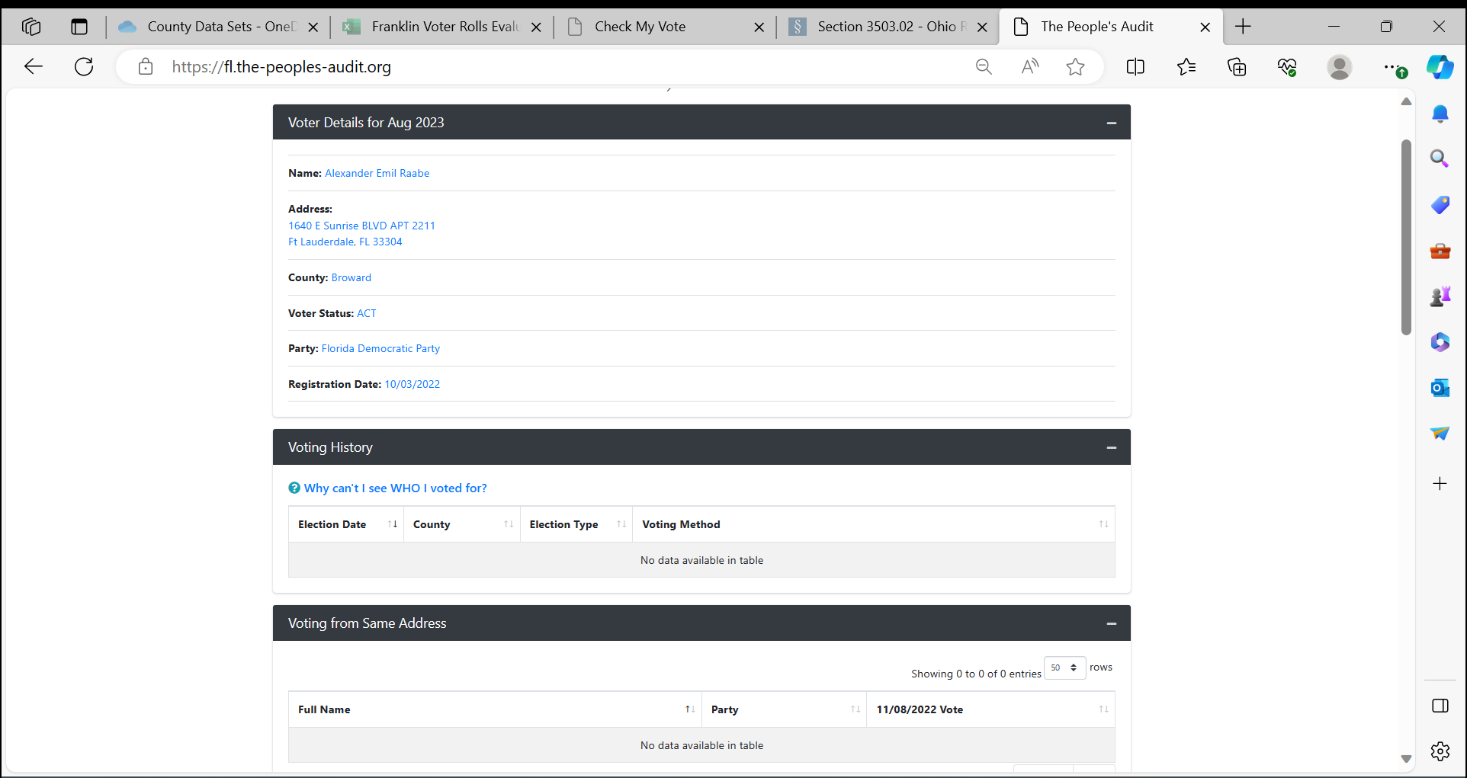

Slide 21
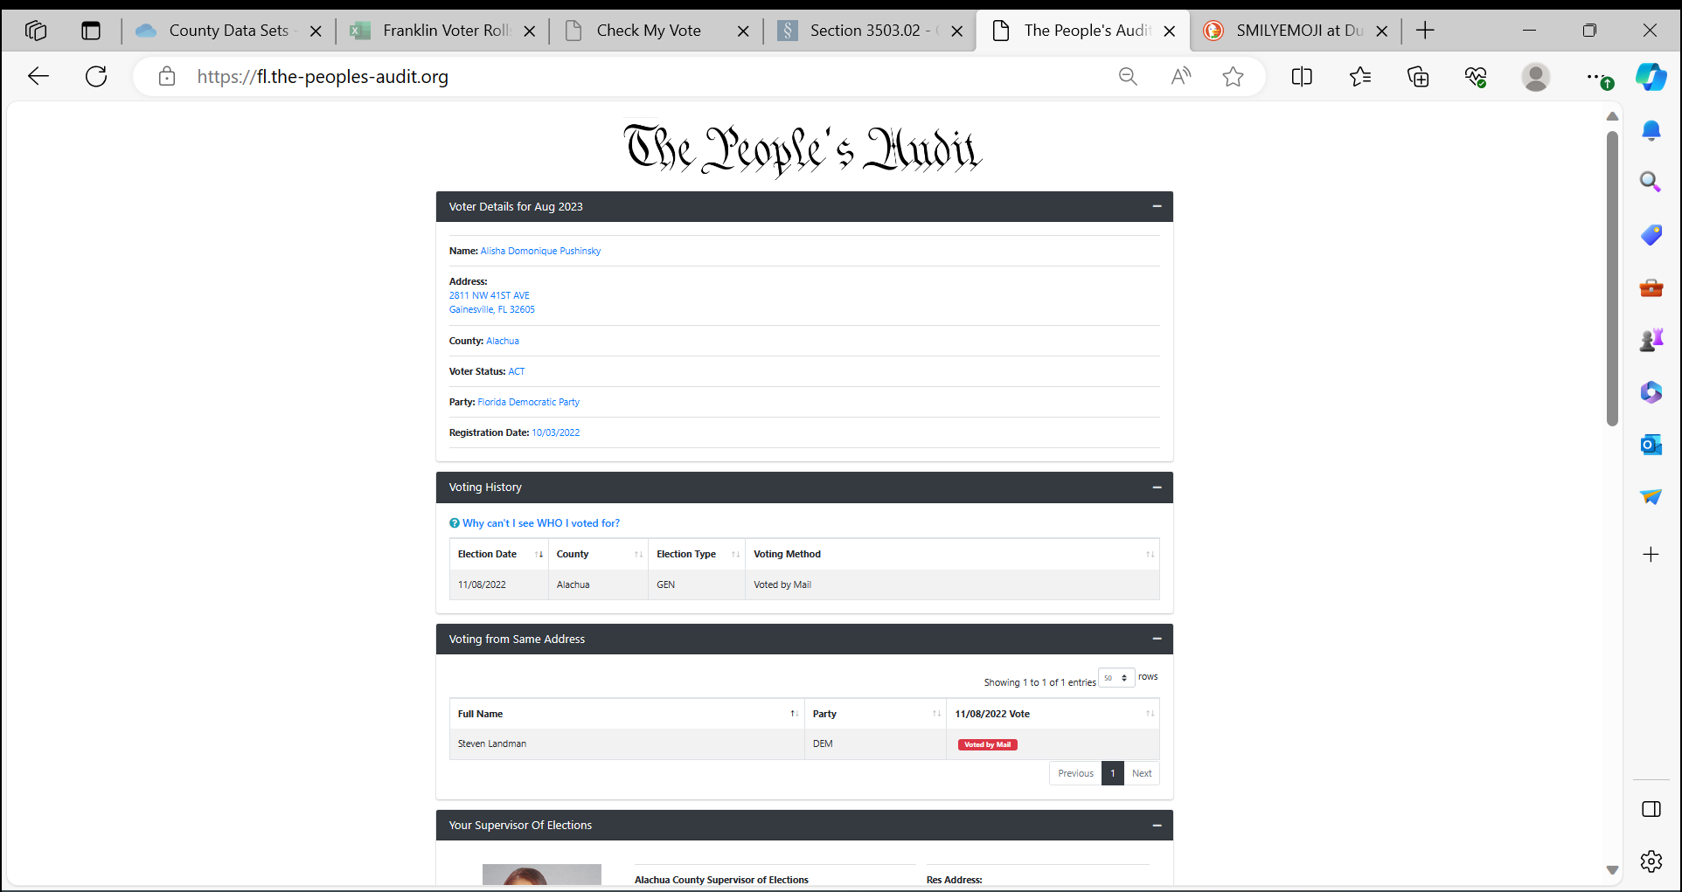

Slide 22
FLORIDA
SCREENSHOT ONTO WORD DOC
SEND TO TEAM LEADER
KEEP EACH STATE INFORMATION SEPERATE

Slide 23
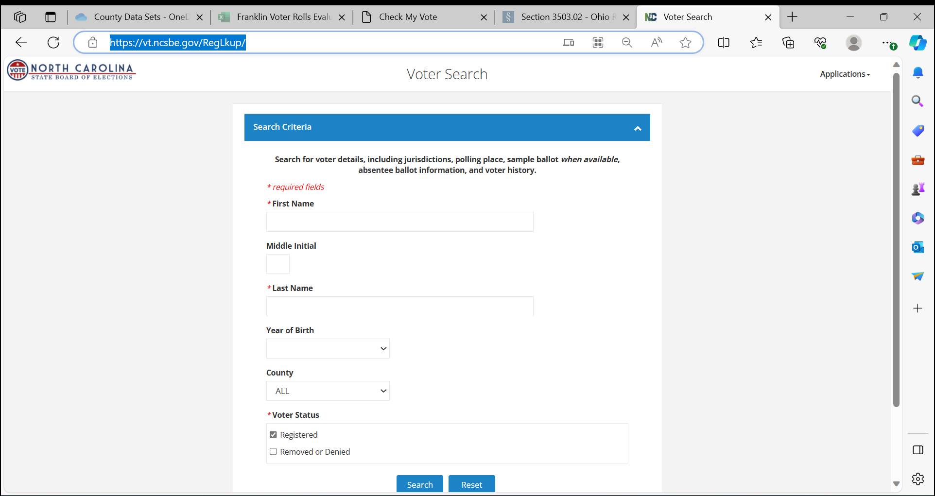
NORTH CAROLINA
Go to Voter Search (ncsbe.gov)

Slide 24
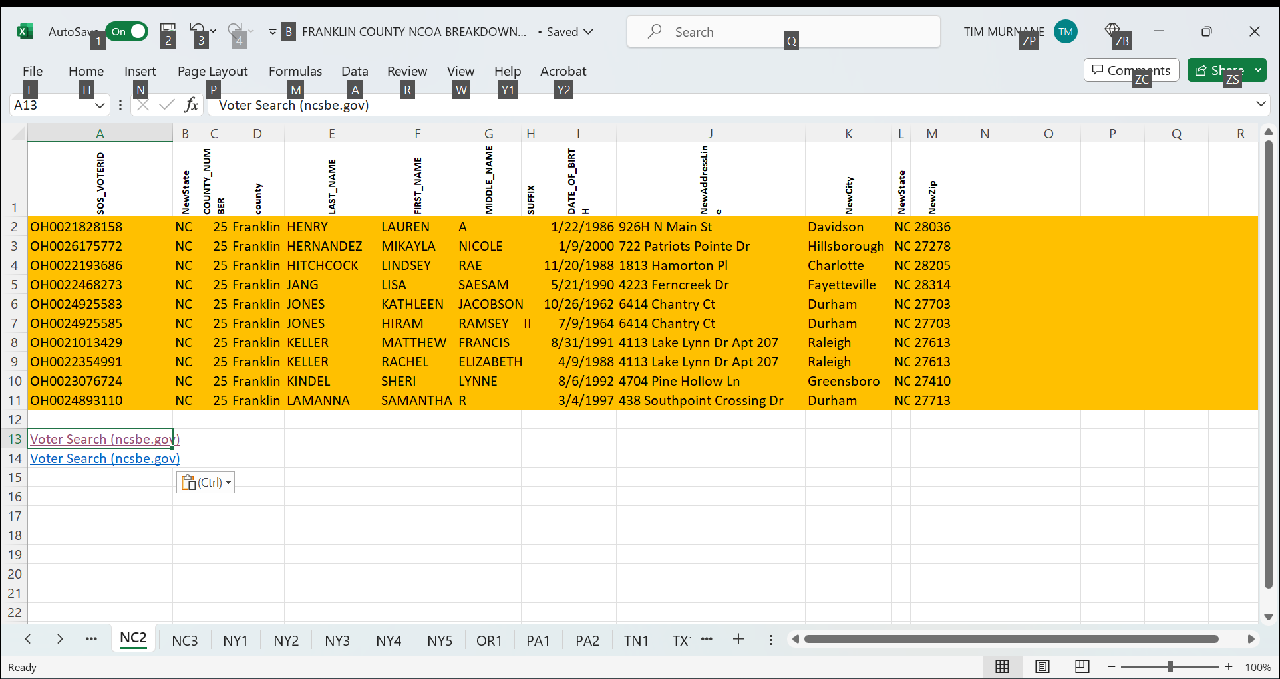

Slide 25
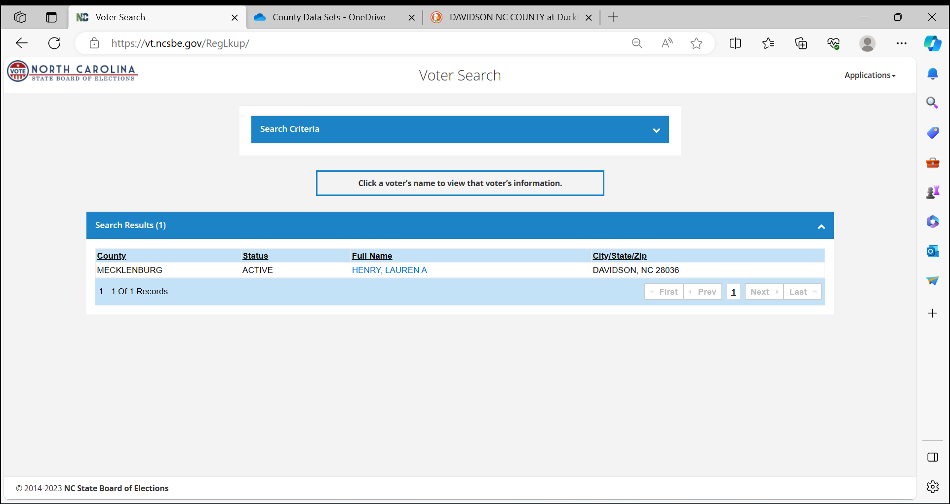

Slide 26
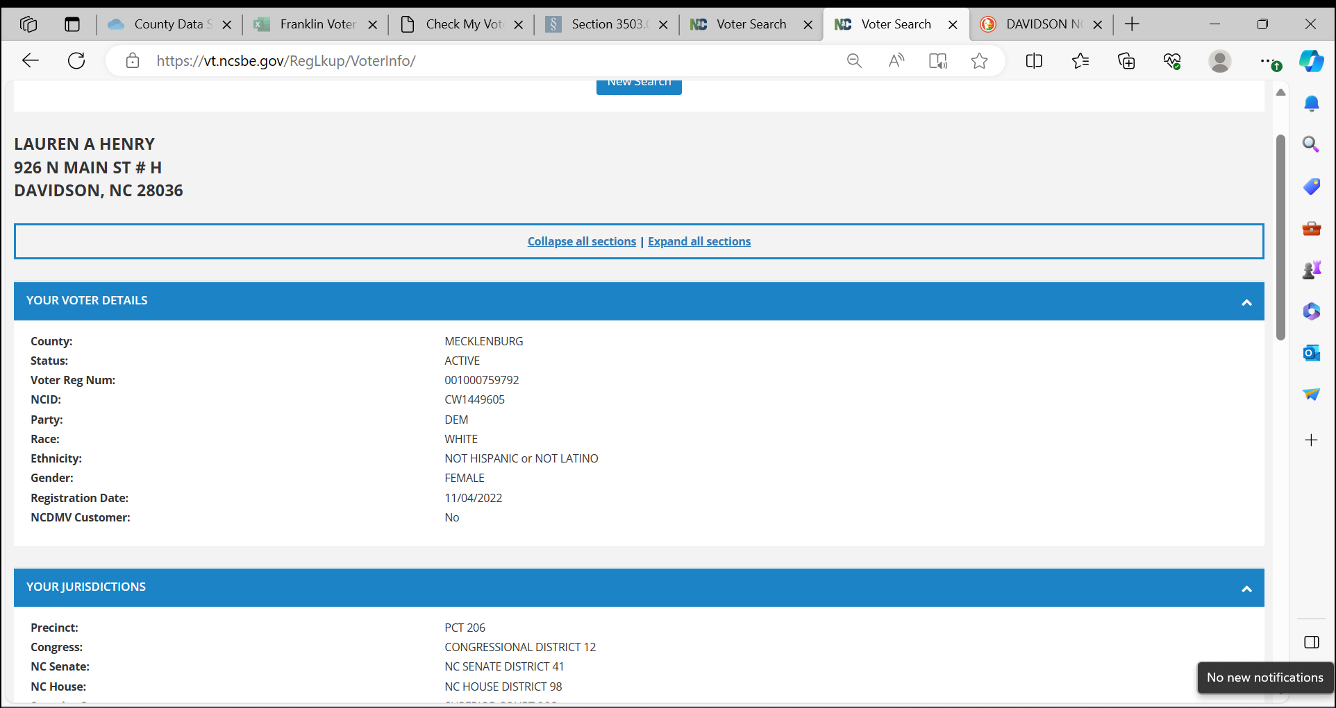
TAKE A SCREENSHOT HERE, PASTE TO WORD DOC,
THEN SCROLL TO THE BOTTOM

Slide 27
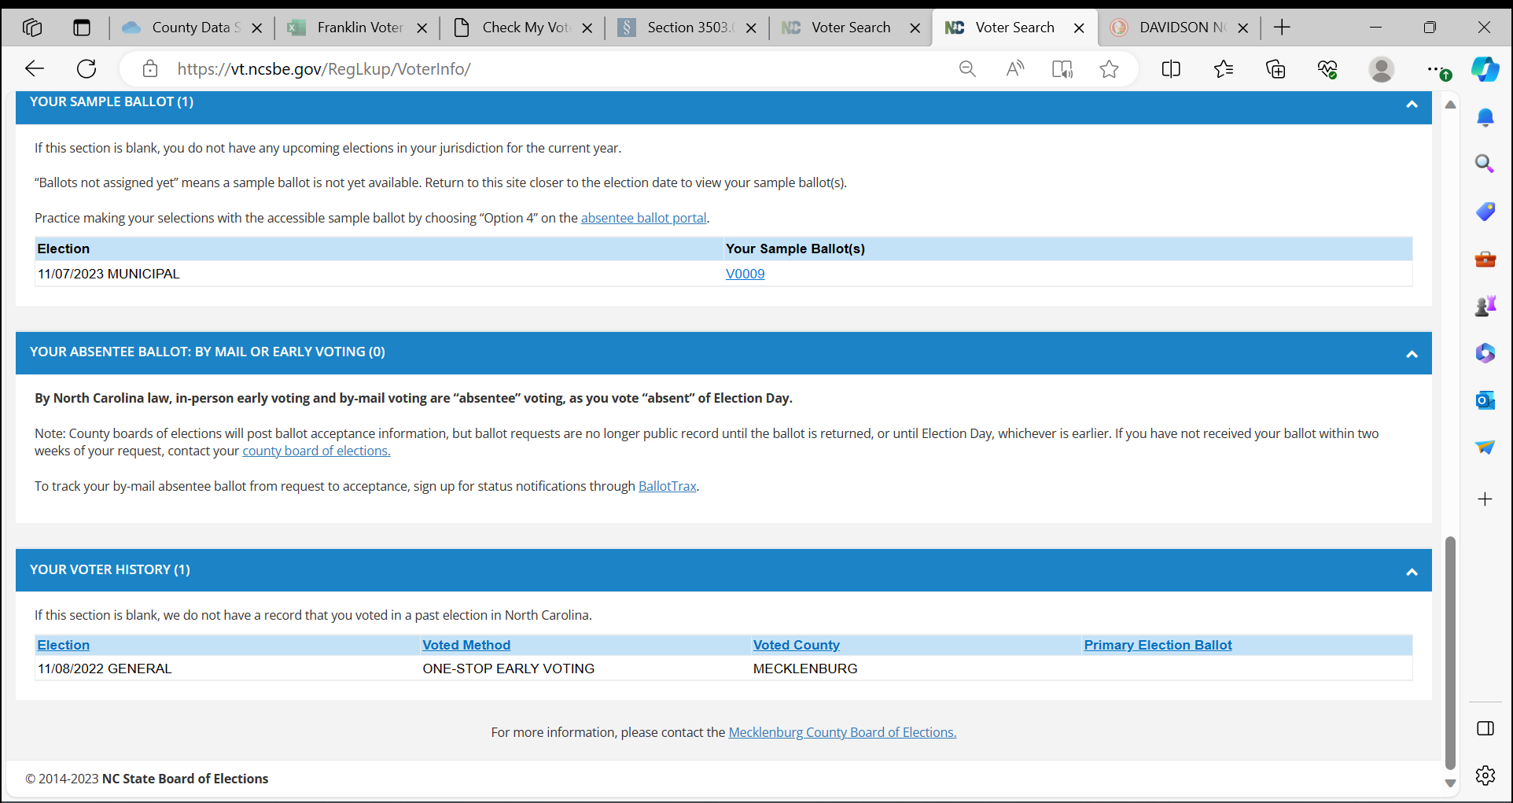
TAKE ANOTHER SCREENSHOT HERE, PASTE TO SAME
WORD DOC,
SAVE THAT WORD DOC, SEND TO LEADER

Slide 28
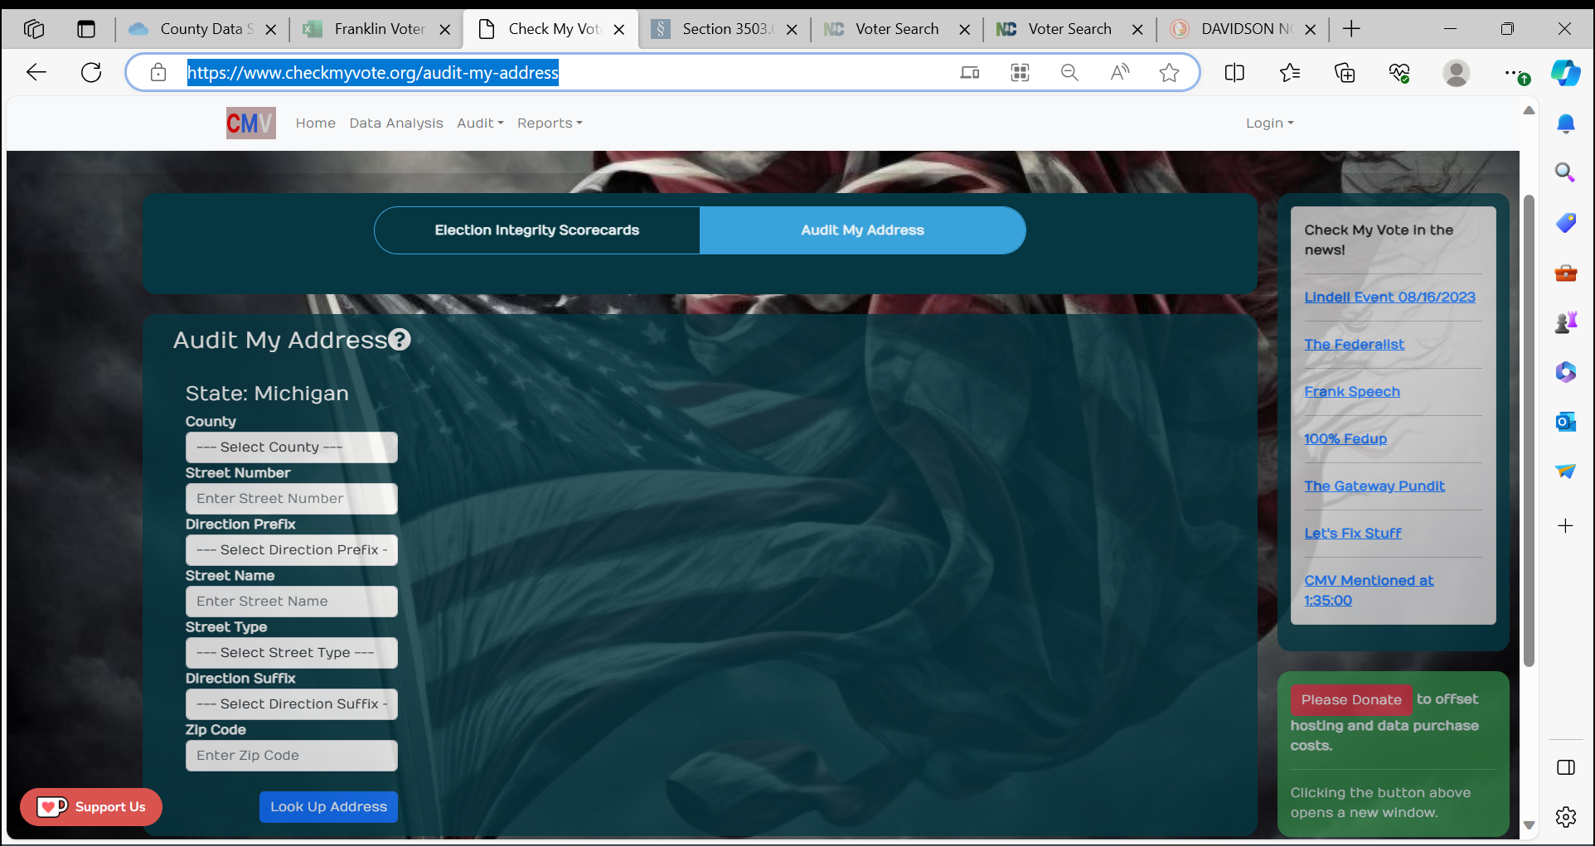
MICHIGAN
Go to Check My Vote

Slide 29
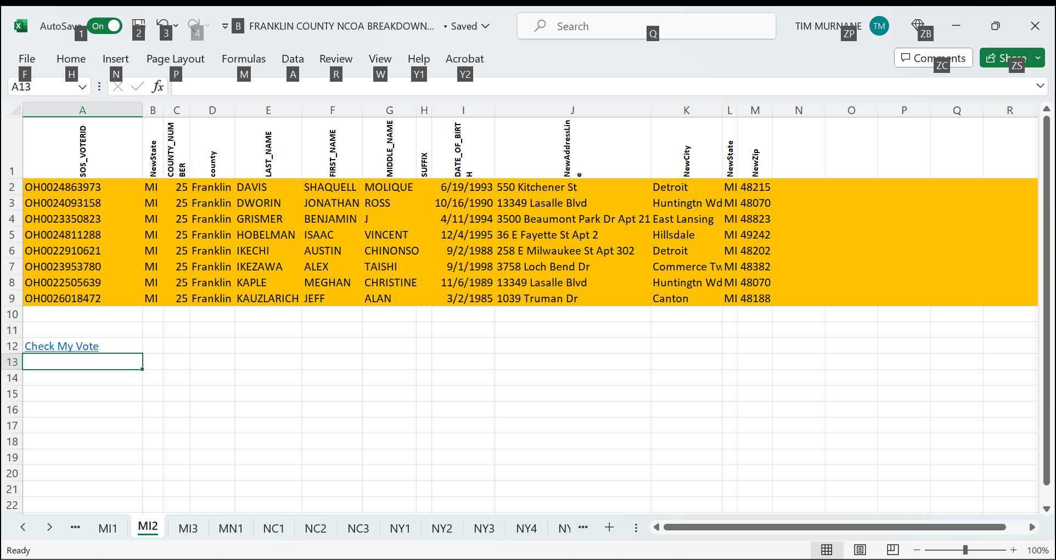

Slide 30
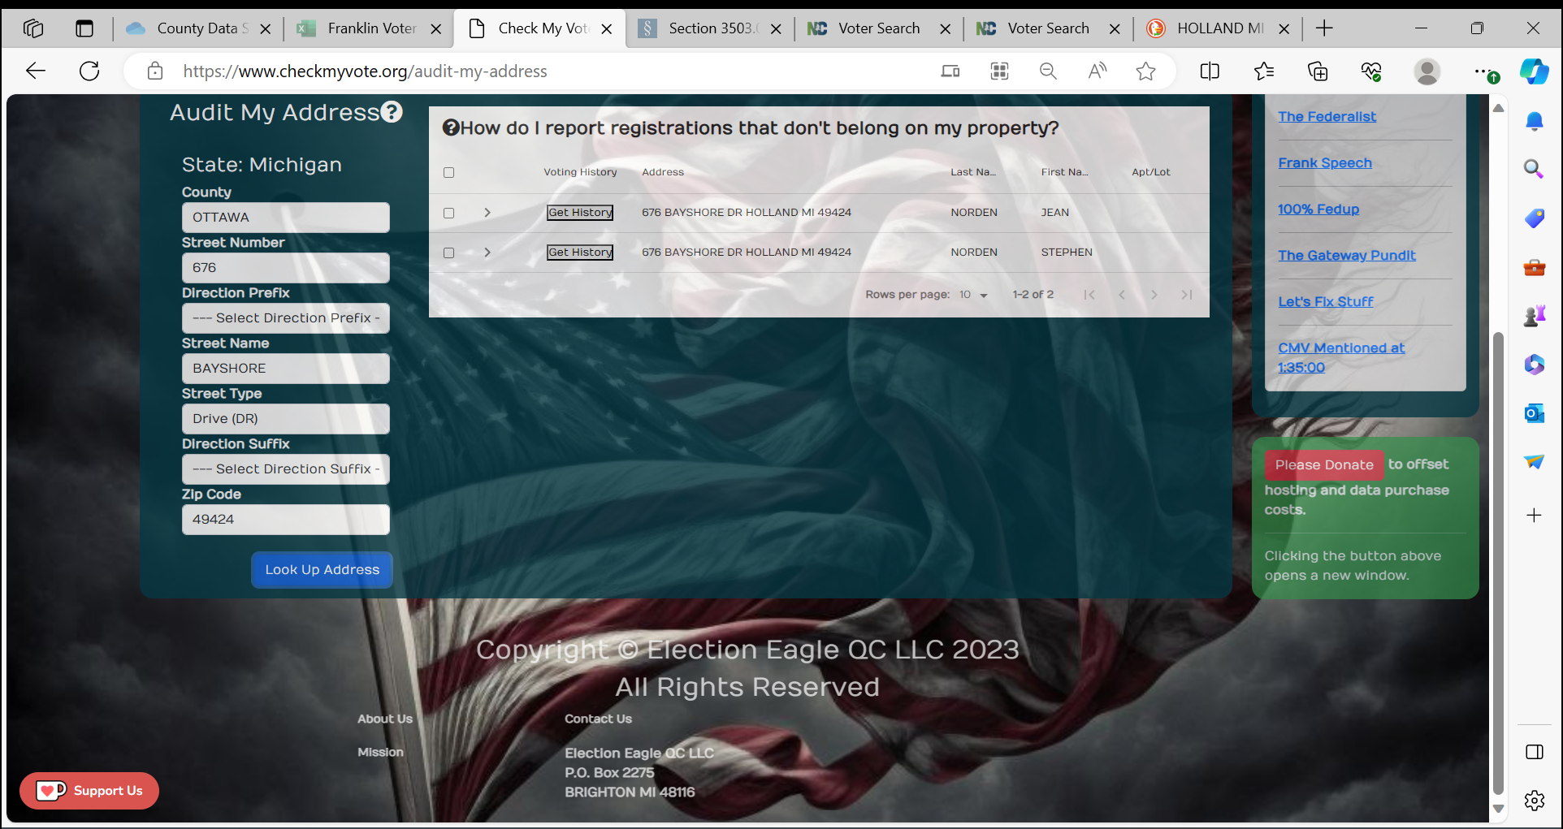

Slide 31
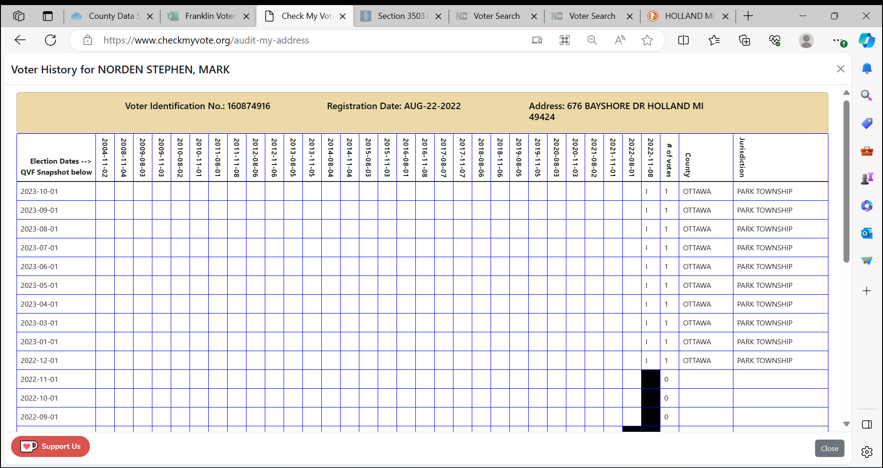
TAKE SCREENSHOT HERE, PASTE TO
WORD DOC
SAVE THAT WORD DOC, SEND TO LEADER

Slide 32
I WILL BE SENDING THIS TRAINING POWERPOINT TO ALL COUNTY LEADERS
If you want your own copy, email
tpmurnane66@charter.net

Slide 33
CHECK WITH YOUR COUNTY TASK FORCE LEADER
Tim Murnane
tpmurnane66@charter.net

